Slide 1
NoC with RISC V 32IM
Group 1
E/17/286 Tharindu Ratnayake
E/17/064 Dhushintha Ramalingam

Slide 2
RISC - V Pipelined CPU
Control Unit
PC
Instruction Memory
Instruction Cache
Register File
Immediate Select Module
Data Memory
ALU
Data Cache
Branch Select Module

Slide 3
What is a Network on Chip?
NoC is a Communication Infrastructure that uses a packet switched network to connect multiple processing elements and memories within a Chip.

Slide 4
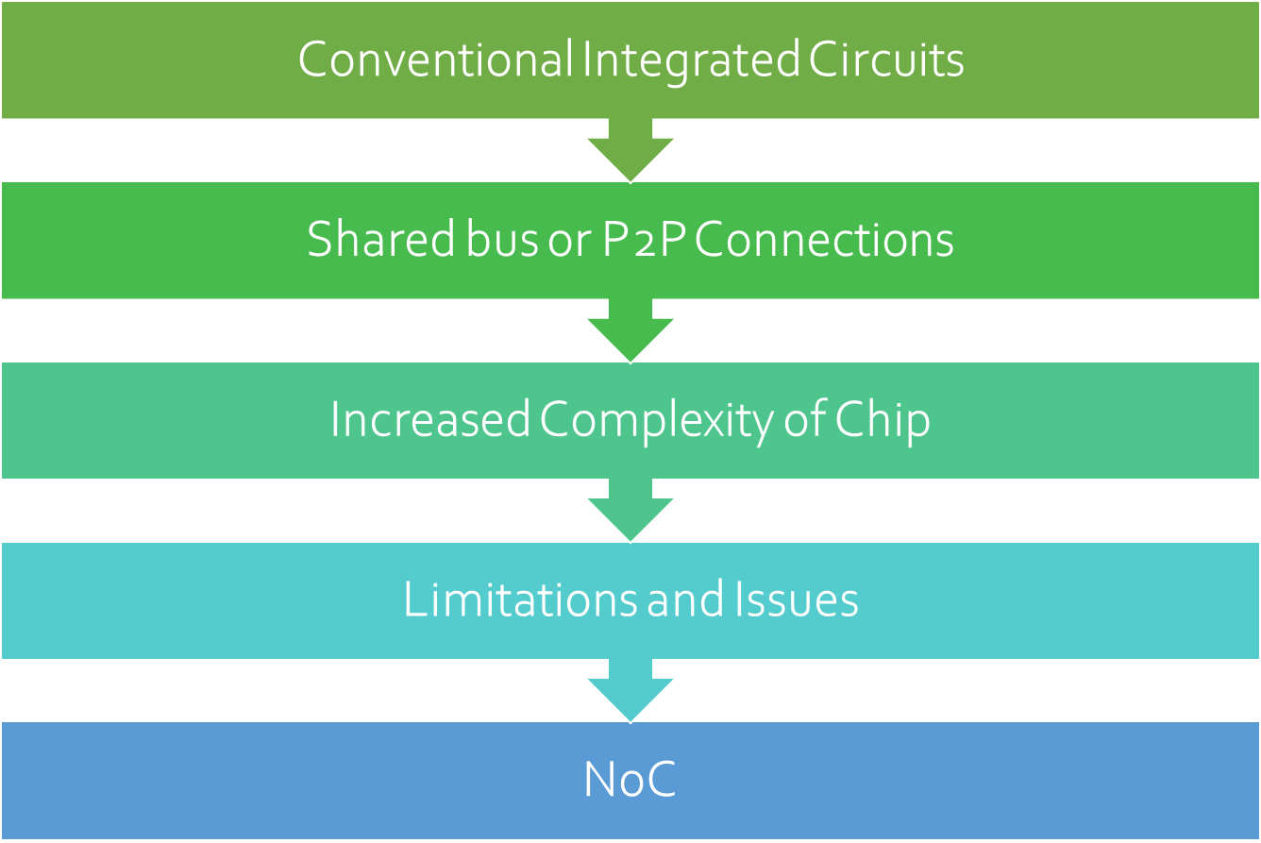
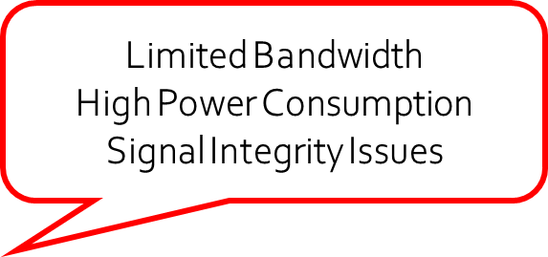
Why NoC?

Slide 5
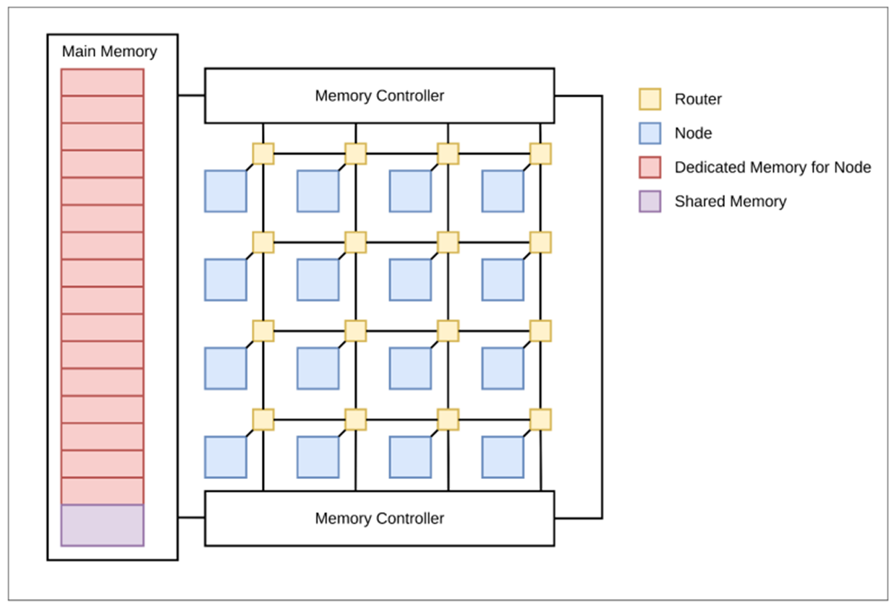
NoC Design - Architecture
main hardware components of the NoC,
● Nodes
● Routers
● Main memory
● Memory Controller

Slide 6
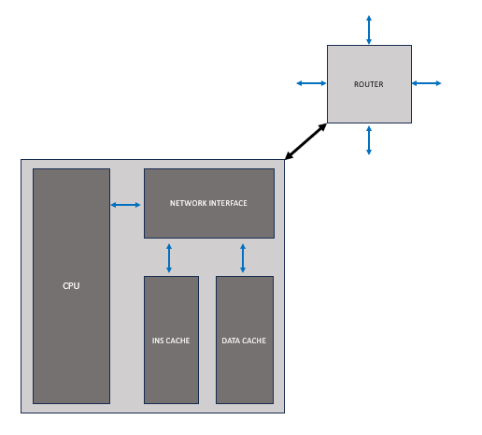
NoC Design - Architecture
Node contains the following components,
● RV32IM CPU
● Router
● Network interface
● Instruction cache
● Data cache

Slide 7
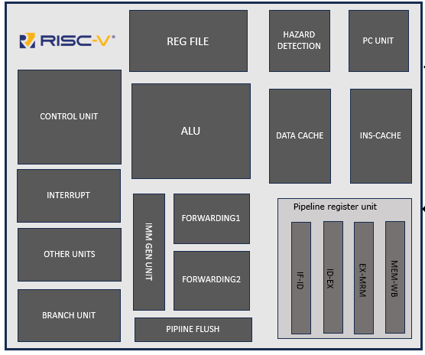
NoC Design - RV32IM CPU

Slide 8
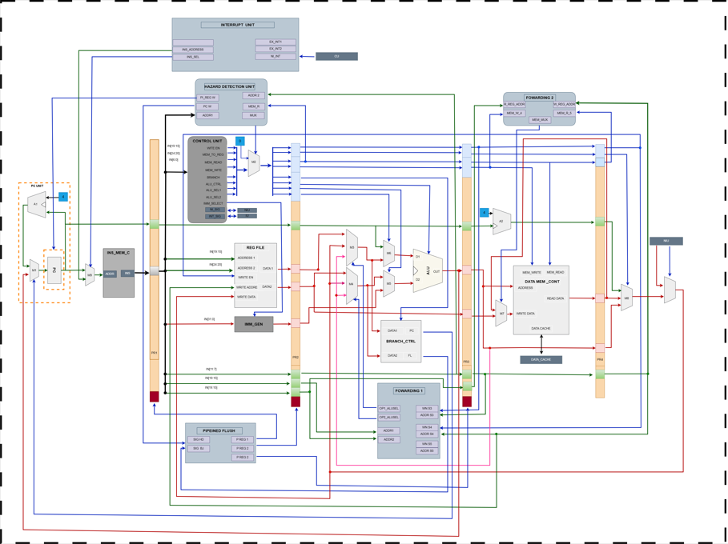
NoC Design - RV32IM CPU

Slide 9
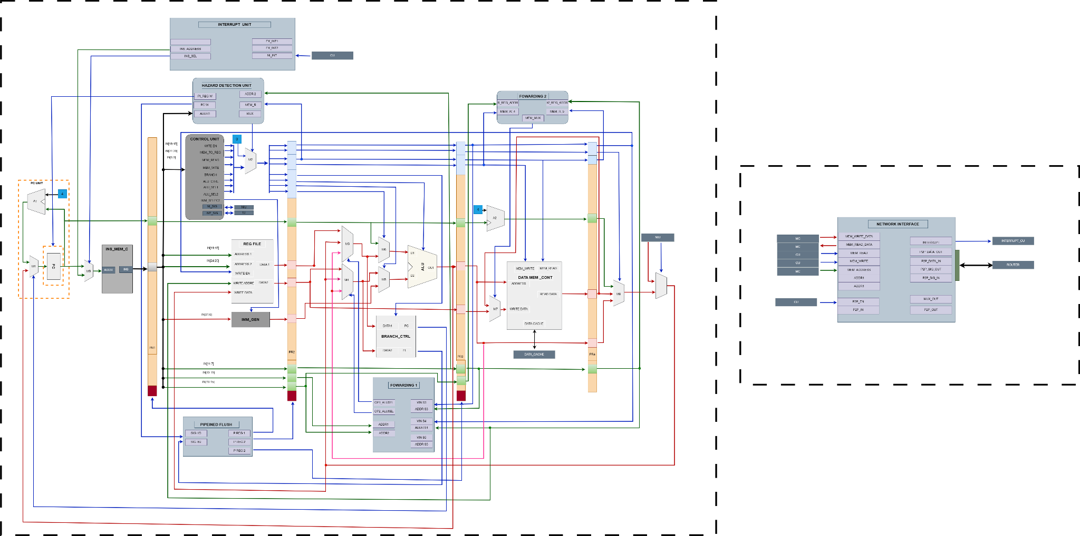
NoC Design - RV32IM CPU

Slide 10
NoC Design - Communication
On Chip Communication with concept of packet switching
Network based Communication
Communication Protocols:
Synchronous
Asynchronous
Globally Asynchronous and Locally Synchronous

Slide 11
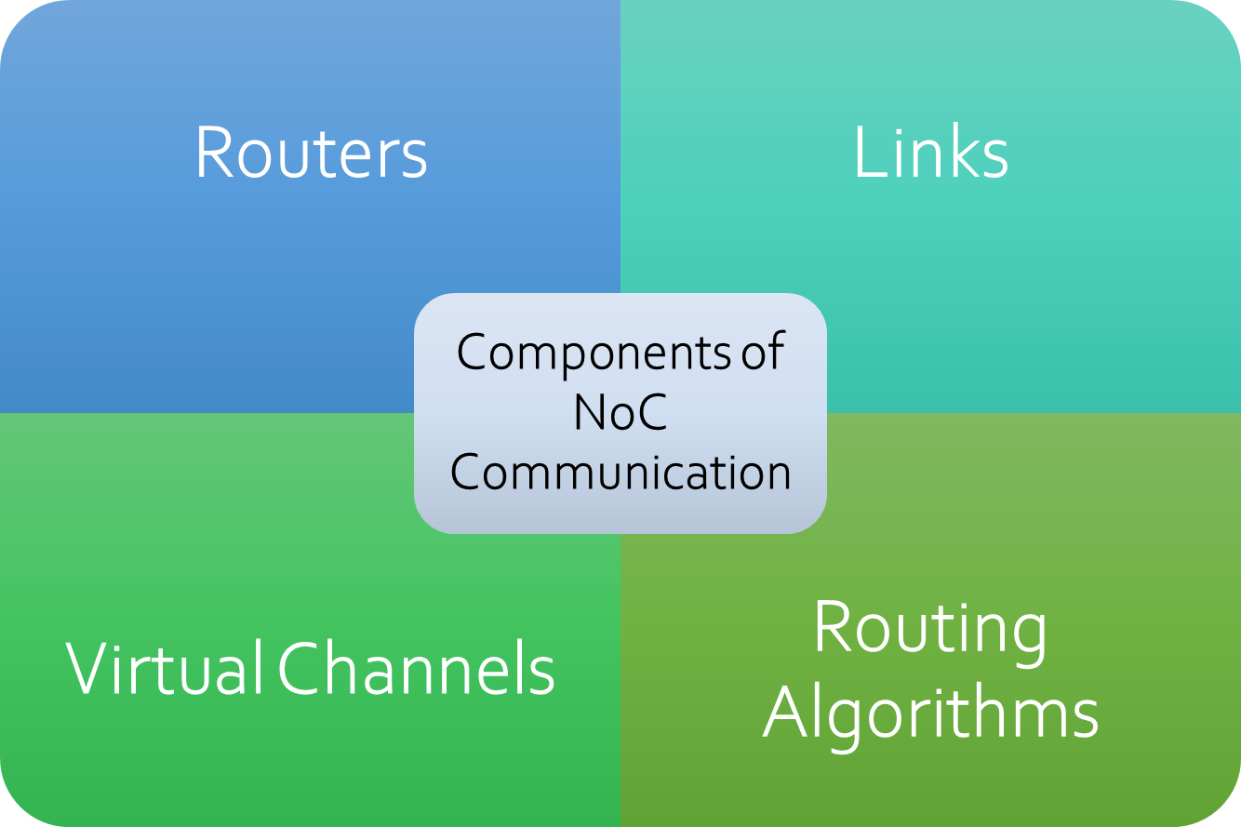

Point to Point Communication
Multicast Communication
Collective Communication

Slide 12
Packet Structure

Slide 13
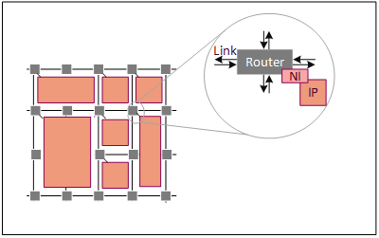
NoC Design - Router
Main Function of a router in NOC
Determining the route in which the packets has to be forwarded
Flow controlling
Network Connectivity:

Slide 14
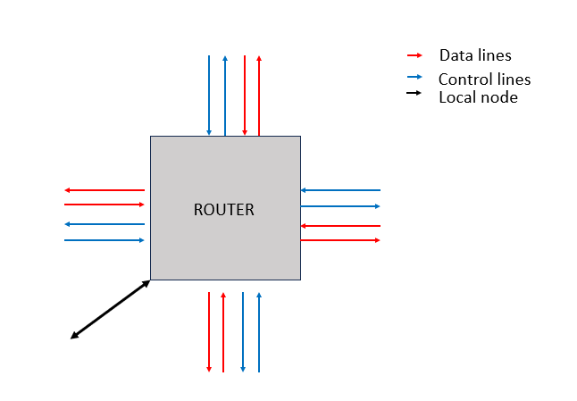
NoC Design - Router
Flow control mechanism
-Virtual channel flow control
Routing algorithm
North Last
Allocater /arbiter
- Round robin arbiter

Slide 15
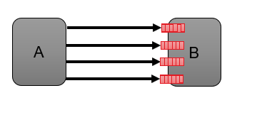
NoC Design - Router
Virtual channel flow control
Multiplex a single physical channel among different virtual channels.
Have a separate buffer queue for each virtual channel
Each physical channel split into
two virtual channels.
No HoL blocking.

Slide 16

NoC Design - Router
Allowed Turns
Routing algorithm
North Last
Provably deadlock free
High path diversity, and congestion avoidance capability
Turns Disallowed
N -> W, N -> E

Slide 17
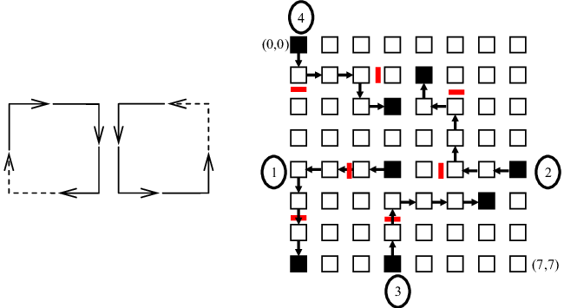
NoC Design - Router
Routing algorithm
North Last

Slide 18
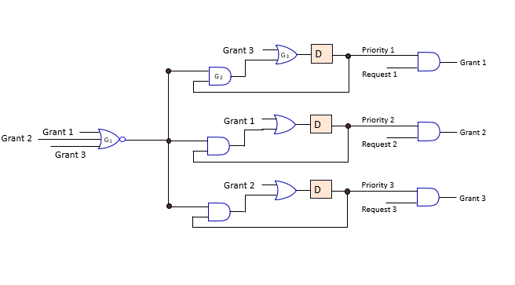
NoC Design - Router
Allocater /arbiter
Round robin arbiter
A widely used arbitration scheme in network-on-chip (NoC) designs.
Provides fair and cyclic allocation of resources to requesting nodes.
Maintains a queue or list of requesting nodes waiting to access a shared resource.

Slide 19
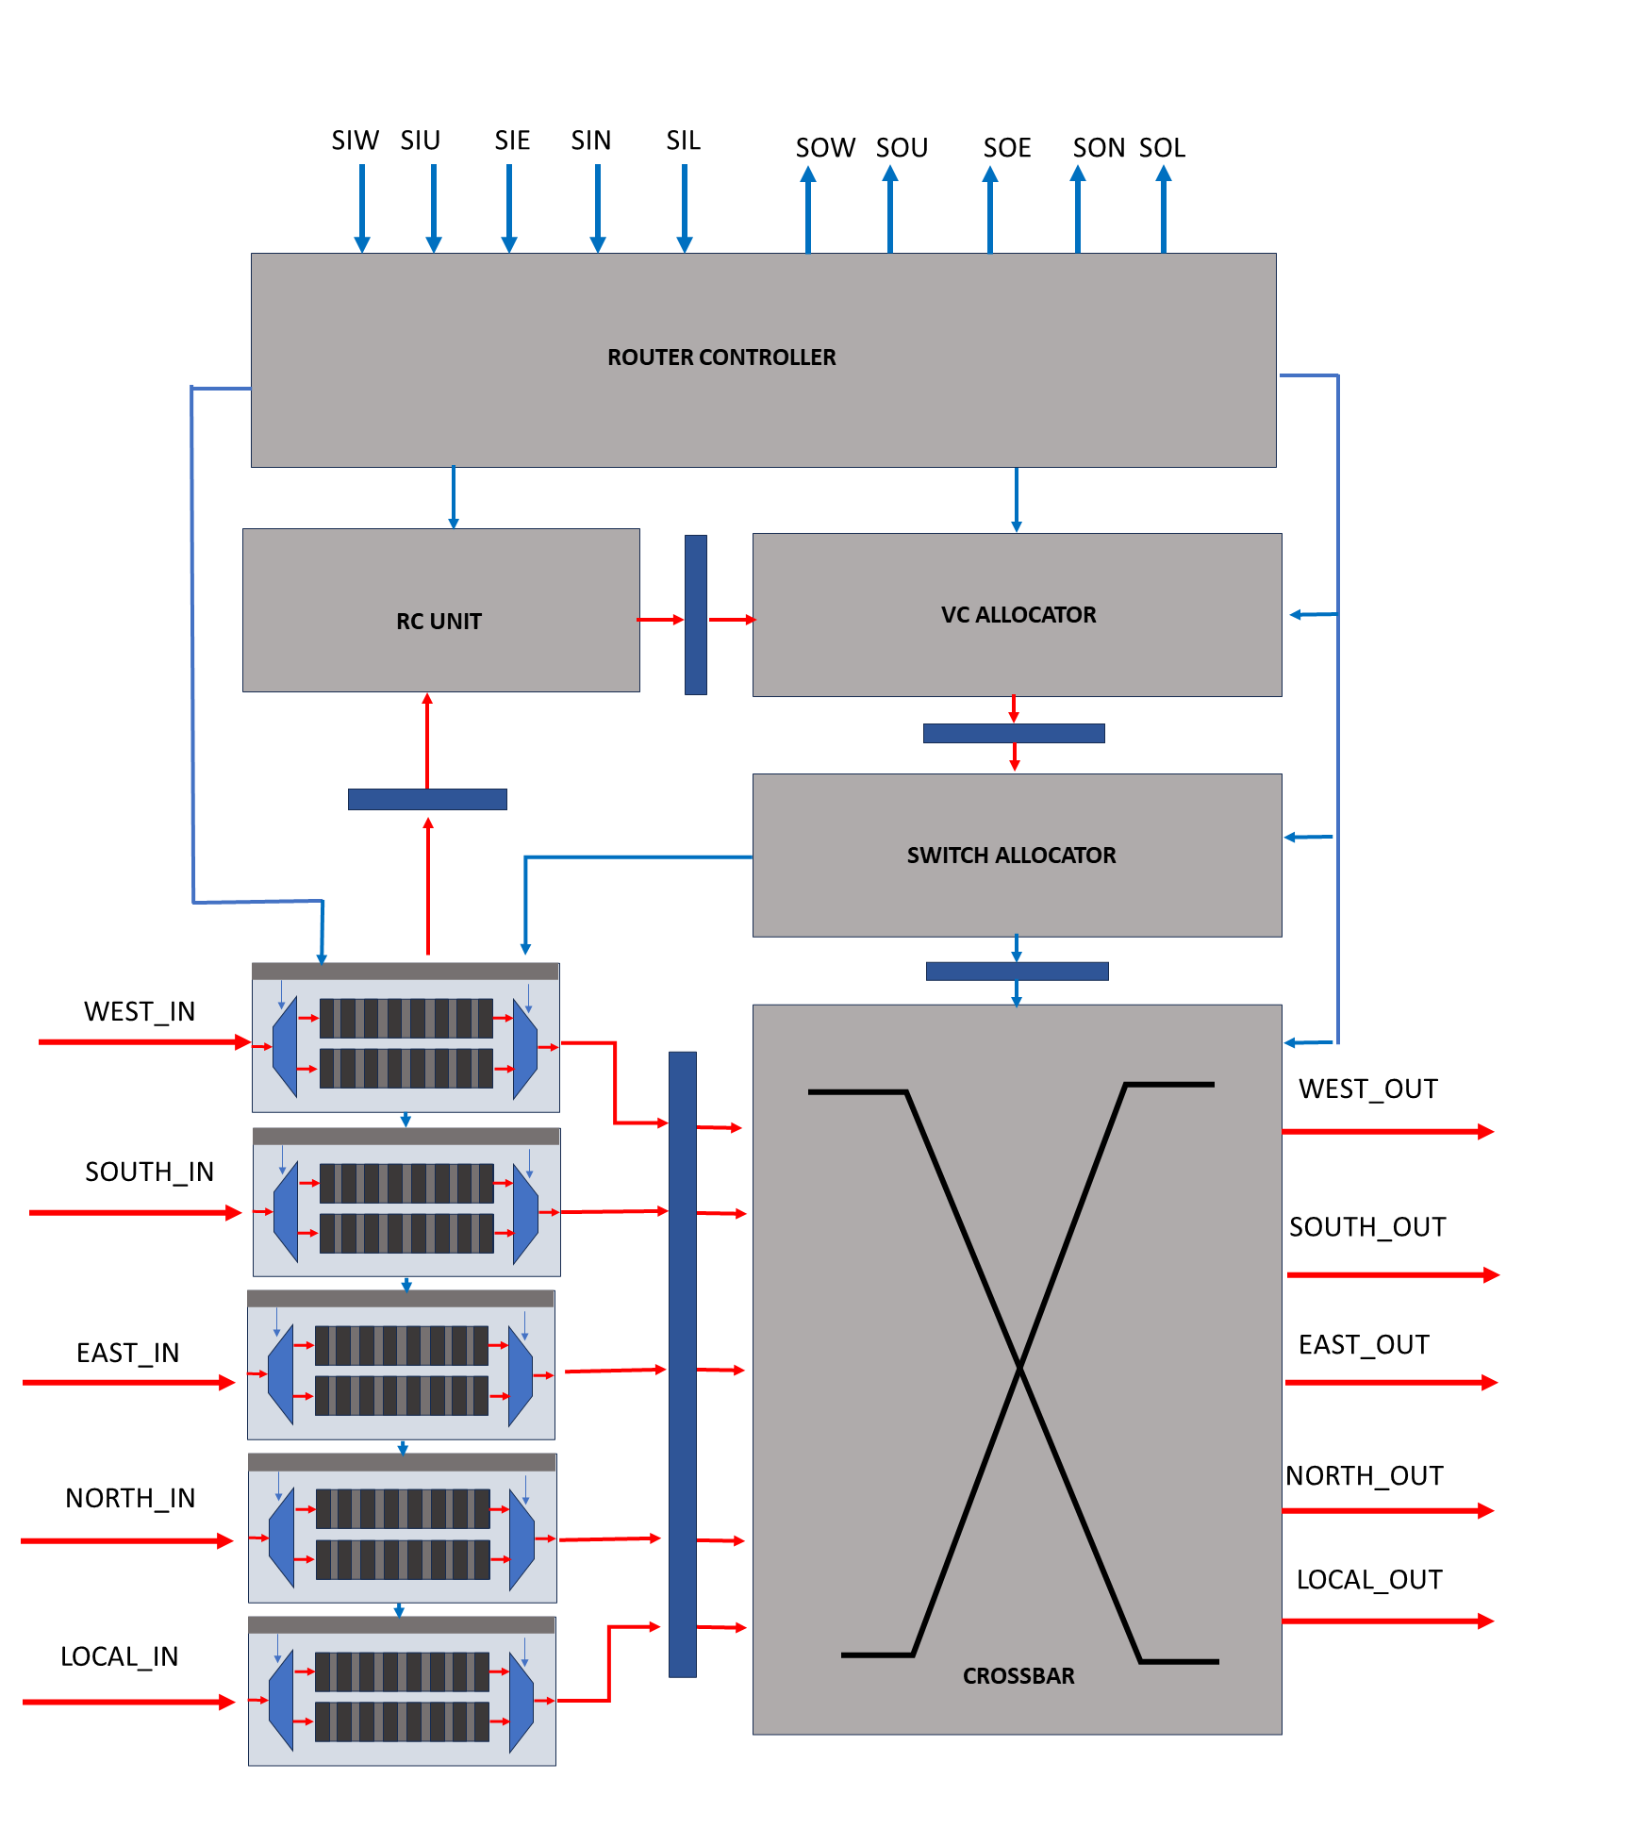
NoC Design - Router
Five stages pipelined
-Buffer write
-Route Computation
- Virtual channel Allocation
- Switch Allocation
- Switching

Slide 20
NoC Design - Network Interface
responsible for the interconnection of the node containing the CPU core and the local caches with the router,
responsible for the interconnection of the node containing the CPU core and the local caches with the router

Slide 21
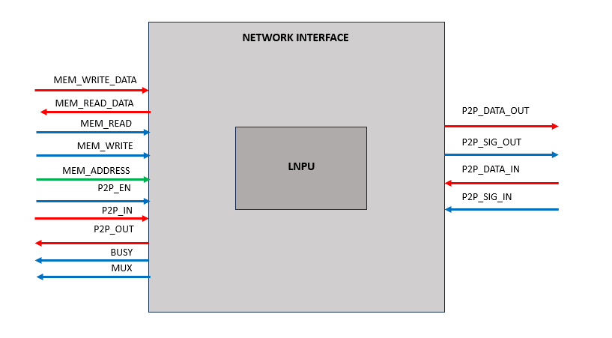
NoC Design - Network Interface

Slide 22
NoC Design - Network Interface
Local node processing unit
responsible for creation and disassembling the packet.
Packets will be created based on the signals coming from the network interface and when a packet is received to the local node

Slide 23

NoC Design - Memory Management
Main memory of size 17 kB
Shared memory space of 1 kB
Memory Controller for
Serving memory requests from nodes
Control Read & Write from memory
Maintaining the cache coherency

Slide 24
NoC Design - Challenges and Problems Encountered

Slide 25
NoC Design - Solutions to the Challenges

Slide 26
Alternative Solutions

Slide 27
Thank You!
Q & A

Slide 28
Introduction & (why NOC is better than Single core
Difficulty/ Complexity in dev NOC
Big picture
Existing nodes router design
Difficulties & issues
How to overcome

